Slide 1
ECE 322L
Electronics 2
03/26/20 - Lecture 17
Frequency response of an amplifier (1)

Slide 2
Update and overview
Midterm will be available on UNM Learn starting on Tue 03/31/2020, 10:30 am and it will be due on on Tue 04/01/2020 via upload to UNM Learn at 12:30 pm.
Homework 8 is online. Please upload your assignment on UNM Learn by Thu, 04/02/20 at 11 am.
All lab reports are due on Friday, April 3rd, 2020 at 5 PM (Please, e-mail a copy to the TA).
Today:
Overview of the frequency response for a n amplifier.
Frequency response of an amplifier with circuit capacitors (Neamen 7.1 and 7.3)
3/26/2020

Slide 3
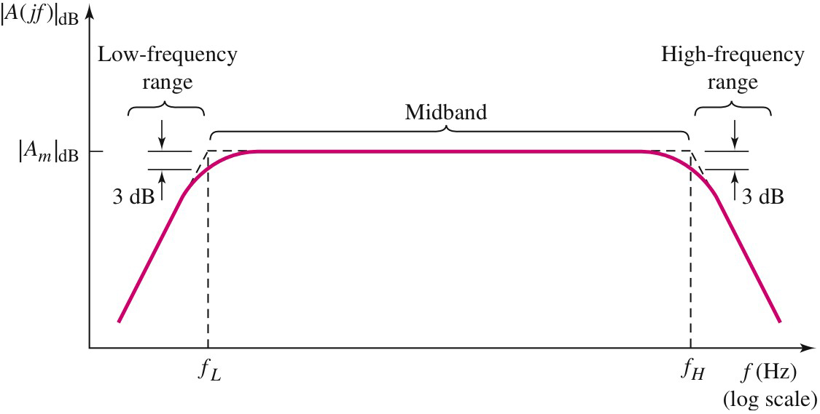
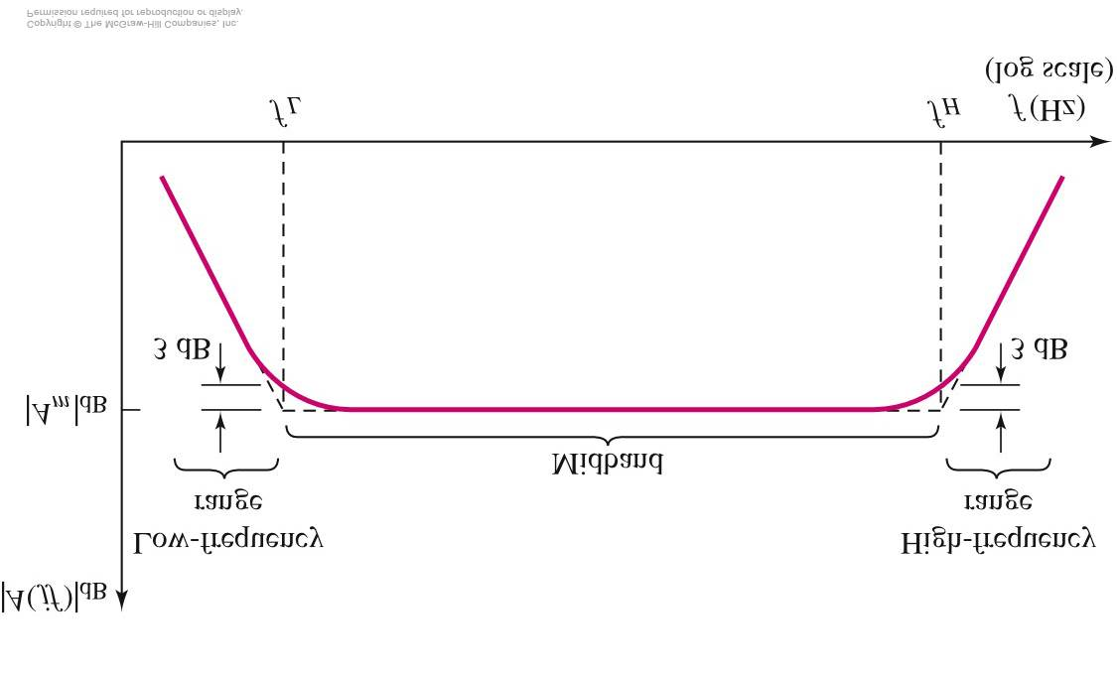
Amplifier Gain Versus Frequency
Bandwidth
Midband
Note: In our analysis of amplifiers’ frequency response we’ll consider
the midband and bandwidth as coincident.
3/26/2020
Notes:
This slides shows the amplitude of an amplifier gain vs. frequency. You notice that gain is constant in amplitude within an intermediate frequency range and it roll’s off at high and low frequency. The roll-off is due to the effect of the capacitors in the circuit on the transfer function of the amplifier.

Slide 4
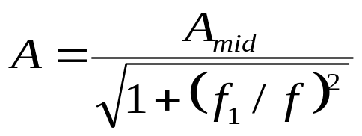
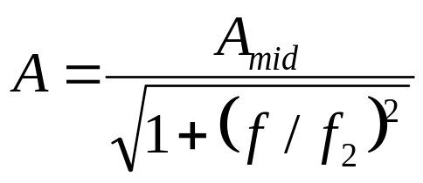
Definitions
Frequency response of an amplifier is the graph of its gain versus the frequency.
Cutoff frequencies (f_{L}, f_{H}) the frequencies at which the voltage gain equals 0.707 (3 dB) of its maximum value.
Midband : the band of frequencies between 10f_{L} and 0.1f_{H} where the voltage gain is maximum. The region where coupling & bypass capacitors act as short circuits and the stray capacitors and transistor capacitors act as open circuits.
Bandwidth : the band between upper and lower cutoff frequencies
Outside the midband, the voltage gain can be determined by these equations:
Below midband
Above midband
3/26/2020
Notes:
This slides provides a few useful definitions related the behavior of an amplifier vs. frequency.

Slide 5
Typical capacitor values in amplifiers
In amplifier we have coupling, bypass, internal transistor, stray (or parasitic), and load capacitors.
Different capacitors affect amplifiers’ frequency response in different frequency ranges because they are very different in value.
Typically, in amplifiers
Coupling (C_{C}) and bypass (C_{B}) capacitors are of the order of μF (Large)
Transistor (C_{Q}), stray (C_{S}) and load (C_{L})capacitors are of the order of nF-fF (Small)
3/26/2020

Slide 6
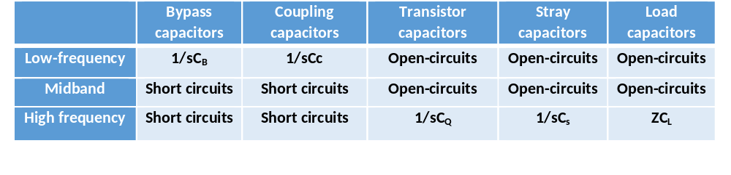
Impedance of amplifiers’ capacitors vs frequency
1/sC_{L}
s=jω , with ω=2πf, and f: frequency
Different capacitors affect amplifiers’ frequency response in different frequency ranges because they are very different in capacitance.
Typically, in amplifiers
C_{C}, C_{B}~μF (Large)-C_{Q}, C_{S}, C_{L}~nF-fF (Small)
3/26/2020
Notes:
The table in this slide summarizes the range of values of the impedances associated with amplifier capacitors at low frequency, high frequency and in the midband. Whenever I indicate that the impedance is going to be 1/sC, I meant that in that in that frequency range the capacitive impedance will be finite at a value determined by the operating frequency of the amplifier and the capacitor value. As you can see in the table, bypass and coupling capacitors affect the amplifier response at low frequency, whereas load, stray, and transistor capacitor are responsible for the roll-off of the gain at high frequency.

Slide 7
How to determine the frequency response
Gain decreases due to coupling and bypass capacitor effects
Gain decreases due to load, parasitic and transistor capacitor effects
Each capacitor has an effect on the gain only at one end of the frequency spectrum, i.e., either the low or the high frequency end.
3/26/2020
Notes:
We will now go into the details of how to determine the frequency response of the amplifier. We will specifically focus on the amplitude of the gain vs. frequency.

Slide 8
How to determine the frequency response
Gain decreases due to coupling and bypass capacitor effects
Gain decreases due to load, parasitic and transistor capacitor effects
Below midband
Above midband
The shape of the frequency response is known. Thus, all that is left to do is determining the midband gain and the cut-off frequencies.
We can accomplish these goals by analyzing 3 different circuits: a low and a high frequency circuits and a midband circuit.
3/26/2020
Notes:
The typical response of an amplifier is mostly characterized by the gain at midband (A_{mid}) and the upper and lower corner frequencies, which are f_{H} (f₂) and f_{L}(f₁), respectively. In the next few slides I’ll show you how to determine the midband gain and the two corner frequencies by modifying the total circuit into a midband, a low frequency, and a high frequency circuit and analyzing the three circuits to obtain the gain at midband, the lower corner frequency, and the upper corner frequency, respectively. I will illustrate the technique with a few examples. For simplicity, in the examples we will neglect the effect of stray and transistor capacitors, for the time being.

Slide 9
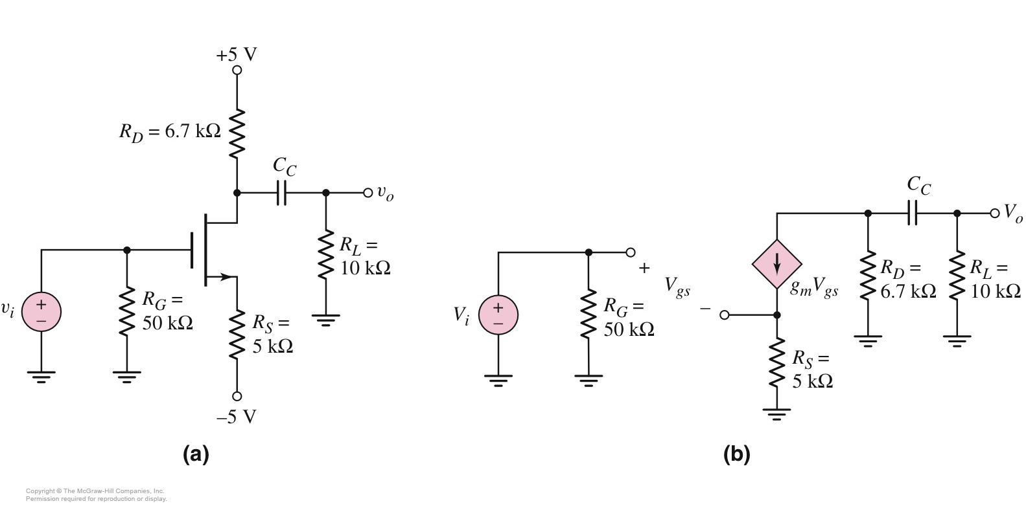
Frequency response of a CS amplifier with an output coupling capacitor
Main steps:
Determine the shape of the frequency response
Sketch ac equivalent circuits
in the relevant frequency ranges
Determine the corner frequency as f=1/2πτ_{C} with τ=R_{eq}C_{C} (R_{eq} is the equivalent resistance seen by the capacitor C_{C})
Calculate the midband gain
λ=0
General circuit
Assumption: we are ignoring stray capacitors and internal capacitors of the transistors
3/26/2020
Notes:
This slides summarizes the steps to generate the frequency response of the circuit. The following slides will illustrate these steps in detail, except for the calculation of the midband gain as we covered that extensively in previous lectures.

Slide 10
Frequency response of a CS amplifier with an output coupling capacitor
Determine the shape of the frequency response
C_{C} is large→1/sC_{C} is finite at low frequency
As the frequency increases in the low frequency range 1/sC_{C} decreases →V_{O} increases
At high enough frequencies 1/sC_{C}
goes to zero and V_{O} is at its maximum
Assumption: we are ignoring stray capacitors and internal capacitors of the transistors
C_{C} leads to a high-pass response
λ=0
4/3/2018
Notes:
By evaluating circuit response in a qualitative way, it is possible to determine the type of frequency response for the amplifier. In general the amplifier has a band-pass response, as shown in the previous slides. However, in this example we are neglecting any effect of the transistor capacitors and stray capacitors. This assumption leads to a high-pass response of the amplifier. Thus, we’ll have to determine the lower corner frequency fL and the midband gain.

Slide 11
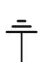
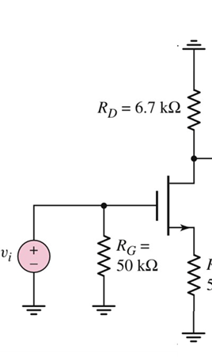

Sketch ac equivalent circuits
General circuit
Low-frequency circuit
Midband circuit
3/26/2020
Notes:
These slide shows the general circuit along with ac equivalent circuits: the low-frequency circuit will be useful to determine the lower corner frequency (f_{L}) and the midband gain. In the next slides and in the notes I’ll focus on how to determine the corner frequency as we have extensively analyzed the midband circuit to determine the gain, during previous lectures.

Slide 12
Frequency response of a CS amplifier with an output coupling capacitor
The corner frequency associated with C_{C} is f=1/2πτ_{C} with τ_{C}=R_{eqC}C_{C}(R_{eqC} is the equivalent resistance seen by C_{C})
λ=0
Calculation of R_{eqC}:
Sketch the low-frequency small-signal circuit
Shut down all the independent sources
Replace C_{C} with a probe source v_{x}
Calculate R_{eqC} as v_{x}/i_{x}
* See notes on UNM Learn
3/26/2020

Slide 13
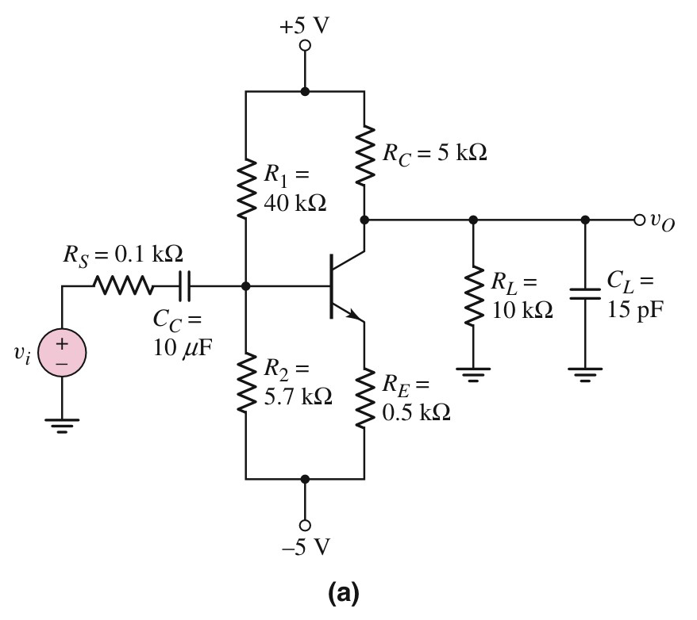
Common emitter with an input coupling capacitor and a load capacitor
Determine the shape of the frequency response
Main steps:
Determine the shape of the frequency response
Sketch ac equivalent circuits
in the relevant frequency ranges
Determine the corner frequencies as f=1/2πτ
Calculate the mid-band gain
V_{A}=∞
Assumption: we are ignoring stray capacitors and internal capacitors of the transistors.
3/26/2020
Notes:
This another example to illustrate how to determine the frequency response of an amplifier. In this case we have a load and a coupling capacitor. Please, pay attention to the two capacitor values that are very different. Again, the steps to determine the frequency response are listed and in the next few slides I will go into details for all the steps except the for the calculation of the midband gain that was previously covered.

Slide 14
Frequency response of a CE with an input coupling capacitor and a load capacitor
Determine the shape of the frequency response
At high enough frequencies 1/sC_{C} goes to zero
C_{L} is small→1/sC_{L} is infinite at low frequency.
At high enough frequencies 1/sC_{L}
becomes finite.
As the frequency increases further in the high frequency range 1/sC_{L} decreases →V_{O} decreases.
C_{L} leads to a low-pass response
C_{C} leads to a high-pass response (as previously found)
As C_{L}<<C_{C} and all resistors have similar orders of magnitude, the corner frequencies determined by C_{L} and C_{C} are very different.
V_{A}=∞
4/3/2018
Notes:
In this slide, we perform a qualitative analysis of the circuit behavior to determine its frequency response. The slides focus on the effct of C_{L} on the response as we have already determined the effect of a coupling capacitor using the previous example.

Slide 15
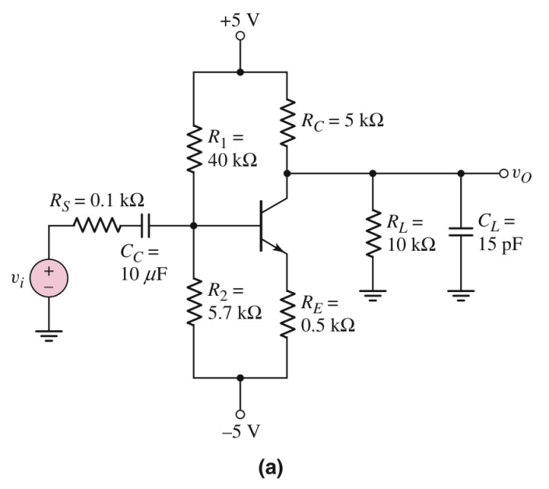


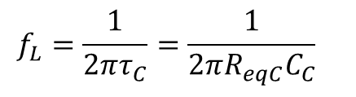
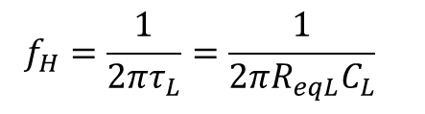
D
LF circuit
Midband circuit
HF circuit
Midband-response
V_{A}=∞
3/26/2020
Notes:
This slide shows the three circuits that we need to analyze to determine the lower corner frequency (LF circuit), the midband gain (midband circuit), and the upper corner frequency (HF circuit). HF: High frequency; LF: Low frequency. The slides also shows the expressions for the upper (f_{H}) and lower (f_{L}) corner frequencies in terms of the load (C_{L}) and coupling (_{Cc)} capacitors respectively.

Slide 16
Common emitter with an input coupling capacitor and a load capacitor
Determine the lower corner frequency as f=1/2πτ_{C} with τ_{C}=R_{eqC}C_{C} where R_{eqC} is the equivalent resistance seen by C_{L})
Calculation of R_{eqC}:
Shut down all the indipendent
sources
Replace C_{C} with a probe source v_{x}
Calculate R_{eqC} as v_{x}/i_{x}
* See notes on UNM Learn
V_{A}=∞
3/26/2020
Notes:
This slide summarizes the steps to determine the lower corner frequency. See notes on UNM learn for more details.

Slide 17
Common emitter with an input coupling capacitor and a load capacitor
Determine the upper corner frequency as f=1/2πτ_{L} with τ_{L}=R_{eqL}C_{L}where R_{eqL}is the equivalent resistance seen by C_{L})
Calculation of R_{eqL}:
Shut down all the indipendent
sources
Replace C_{L} with a probe source v_{x}
Calculate R_{eqL} as v_{x}/i_{x}
* See notes on UNM Learn
V_{A}=∞
3/26/2020
Notes:
This slide summarizes the steps to determine the upper corner frequency. See notes on UNM learn for more details.

Slide 18
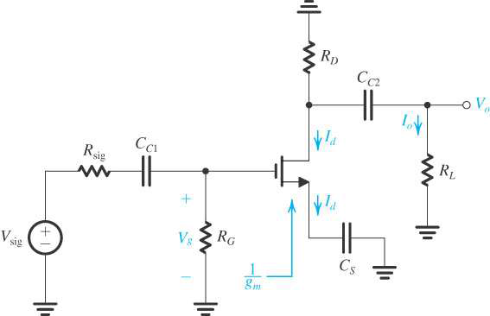
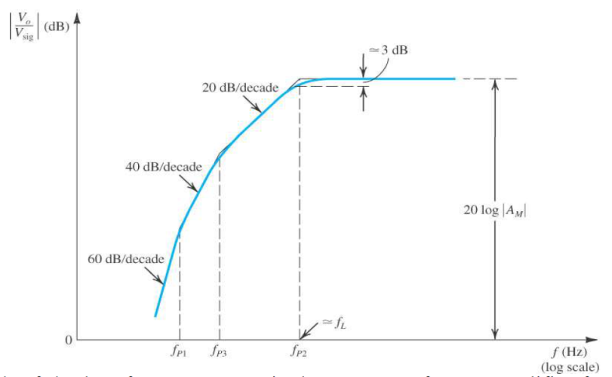
Amplifier with multiple capacitors affecting the response in the low frequency range
* See notes on UNM Learn
Note that we have coupling and bypass capacitors in this circuits, which all affect the frequency response of the amplifier at low frequency.
3/26/2020
Notes:
In the previous example, we either had one capacitor or two capacitors that were relevant in two different frequency ranges. Now we’ll consider a case where we have multiple capacitors affecting the frequency response in the same frequency range, such as two coupling capacitors and one bypass capacitors. These 3 capacitors all affect the frequency response of an amplifier at low frequency. The circuit show here is alow-frequency equivalent circuit of a common source amplifier.

Slide 19
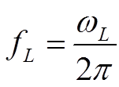
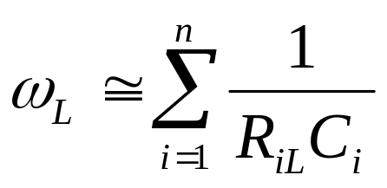
Short-circuit time constant method (SCTC)
Used to determine the low cut-off frequency for a circuit including n capacitors.
Step-by-step method
Draw the ac equivalent circuit including only the capacitors yielding a high pass response (All the other capacitors will act as open circuits)
Calculate the corner frequency determined by each capacitor as ω_{Li}=1/C_{i}R_{iL} by replacing all the other capacitors with short circuits.
Calculate the corner frequency response due to the n capacitors as
R_{iS} = resistance at the terminals of the i^{th} capacitor C_{i} with all the other coupling and bypass capacitors replaced by short circuits.
3/26/2020
Notes:
This slide summarizes all the steps to determine an approximate value of the lower corner frequency for an amplifier with multiple coupling and bypass capacitors. These steps listed above are known as the short-circuit time constant method. Slides 20-24 shows how this method can be applied to a practical circuit.

Slide 20
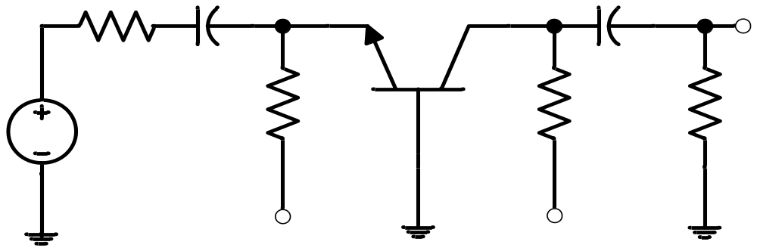
Circuit with two coupling capacitors
Determine the low cut-off frequency of the circuit below
R_{S}
4.7 μF
1 μF
v_{O}
100 Ω
C₁
C₂
R_{E}
R_{C}
R_{L}
v_{S}
43 kΩ
22 kΩ
75 kΩ
-V_{EE}
+V_{CC}
Assumption: we are ignoring stray capacitors and internal capacitors of the transistors.
* See notes on UNM Learn
3/26/2020

Slide 21
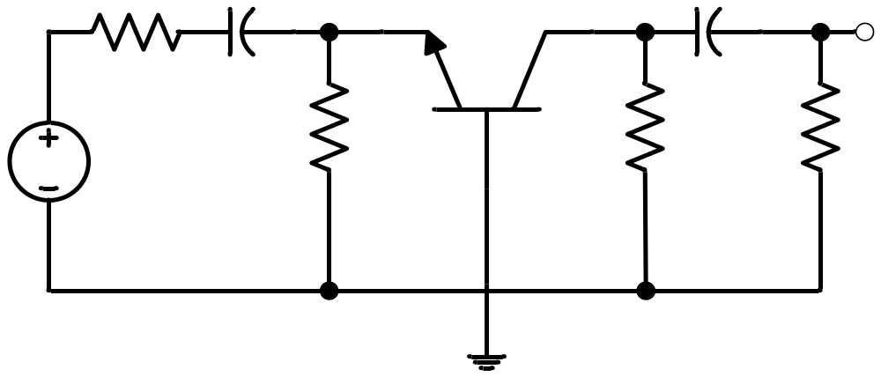
Low-frequency ac equivalent circuit
Frequency response of a circuit with two coupling capacitors
v_{o}
R_{S}
C₂
C₁
R_{E}
R_{C}
R_{L}
v_{s}
Given :
Q-point values : 0.1 mA, 5 V
β = 100, V_{A} = 70 V
Therefore,
g_{m} = 3.85 mS, r_{o} = 700 kΩ
r_{π} = 26 Ω
3/26/2020

Slide 22
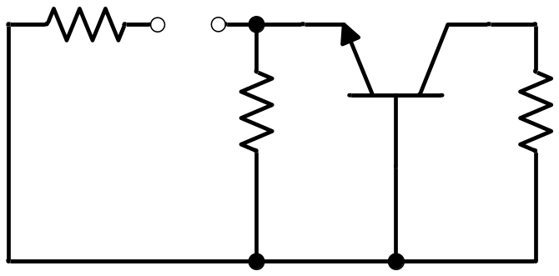
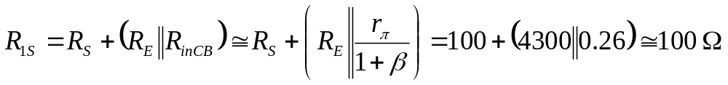
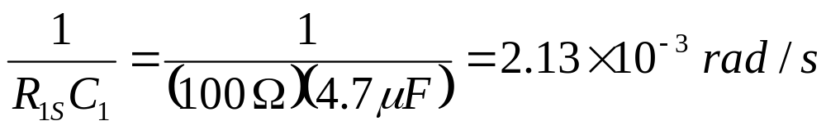
Circuit for finding R_{1S}
Frequency response of a circuit with two coupling capacitors
R_{S}
R_{1S}
Replacing C₂ by short circuit
R_{E}
R_{C} || R_{L}
R_{inCB}
3/26/2020

Slide 23
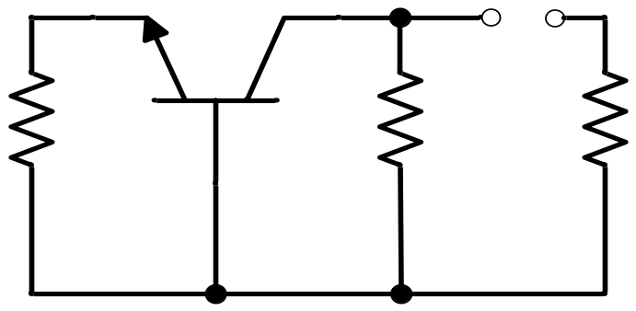
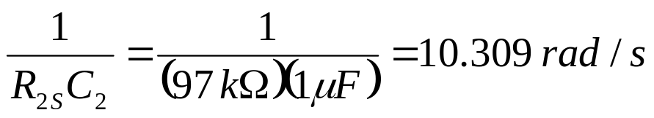
Frequency response of a circuit with two coupling capacitors
Circuit for finding R_{2S}
R_{outCB}
R_{2S}
Replacing C₁ by short circuit
R_{S} || R_{E}
R_{C}
R_{L}
3/26/2020

Slide 24
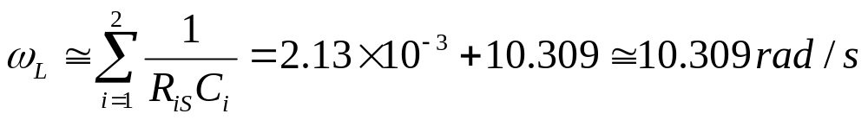
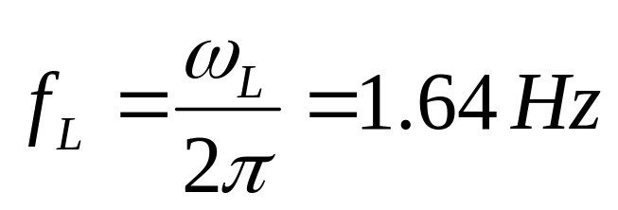
Estimation of ω_{L}
3/26/2020

Slide 25
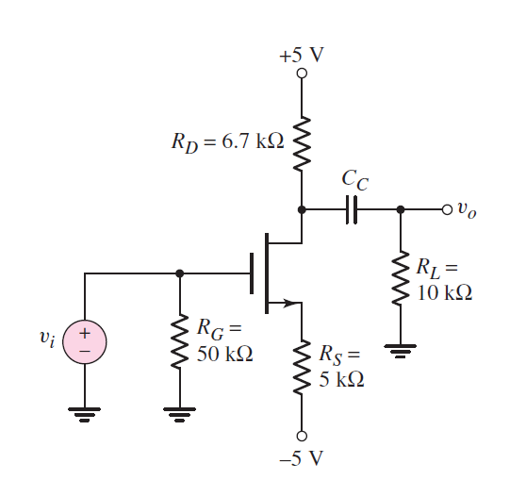
Lecture 17-Take-home problem 1
Design the circuit so that the lower corner frequency is 20 Hz.
See solution on Neamen pp. 489-490
3/26/2020

Slide 26
Overview of lecture 18
High frequency response of BJT-based amplifiers
Capacitance effects in a p-n junction
Parasitic capacitance in a BJT
(Neamen 7.4.1)
Expanded π-model (Neamen 7.4.1)
Miller effect (Neamen 7.4.4-7.4.5)
3/26/2020

